Slide 1
What’s new in Visual Studio 2015
Alim Ul Karim
alim@developers-organism.com
Microsoft Technical Community(MSTC)
Community Speaker of Techforum

Slide 2


Developers Organism
developers-organism.com
info@developers-organism.com
/DevelopersOrganism

Slide 3
Outline
Reason behind switching to Visual Studio 2015
What’s new in the IDE itself?
  What’s new in C# 6.0?
    Auto Property
    Static Import
    Simplified Primary Constructor
    Dictionary Instantiation Change
    Number Representation
    For each new var
  Roslyn Compiler

Slide 4
Outline
What’s new in the IDE itself? (continues)
  Web Platform Improvement
    Grunt and project.json and others
    Optimization of framework
  IDE features
    Code Assistance Light Bulb
    Enhanced Renaming and Refactoring
    Debugging Enhancement
    Layout Customization
  Apache Cordova Universal App development

Slide 5
Reasoning
VS 2013 was so great!
Notes:
In Slide Show mode, click the arrow to enter the PowerPoint Getting Started Center.

Slide 6
Reasoning
Write apps for every platform
Notes:
In Slide Show mode, click the arrow to enter the PowerPoint Getting Started Center.

Slide 7
Reasoning
Refactoring is so much better that you can skip plugins like ReSharper
Notes:
In Slide Show mode, click the arrow to enter the PowerPoint Getting Started Center.

Slide 8
Reasoning
Incredible Debugging features and other IDE features
Notes:
In Slide Show mode, click the arrow to enter the PowerPoint Getting Started Center.

Slide 9
What’s new in
C# 6.0
Notes:
In Slide Show mode, click the arrow to enter the PowerPoint Getting Started Center.

Slide 10
C# Innovations
VS
2002 C# 1.0
2005 C# 2.0
Feature
Hello World!
Generics<T>
2007 C# 3.0
2010 C# 4.0
2012 C# 5
2015 C# 6
LINQ
dynamic
Async
Let’s see

Slide 11
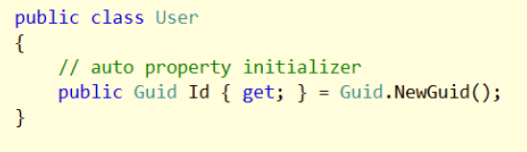
C# 6.0
Auto Property
Notes:
In Slide Show mode, click the arrow to enter the PowerPoint Getting Started Center.

Slide 12
C# 6.0
Static Import
Notes:
In Slide Show mode, click the arrow to enter the PowerPoint Getting Started Center.

Slide 13
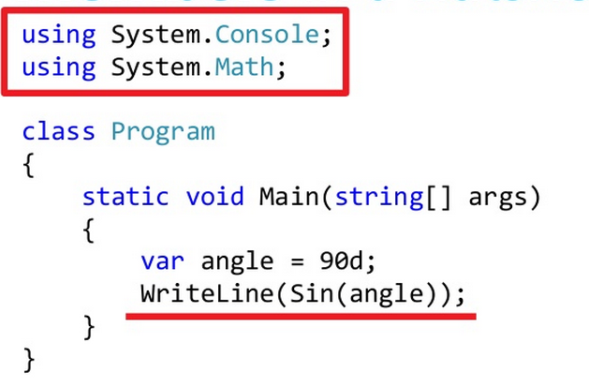
Static Import

Slide 14
C# 6.0
Elegant Dictionary Instantiation
Notes:
In Slide Show mode, click the arrow to enter the PowerPoint Getting Started Center.

Slide 15
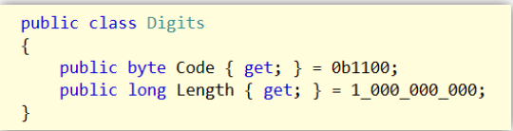
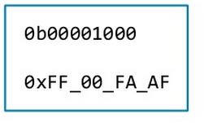
C# 6.0
Number Representation
Notes:
In Slide Show mode, click the arrow to enter the PowerPoint Getting Started Center.

Slide 16
C# 6.0
Simplified Primary Constructor
#inherited from F#
Notes:
In Slide Show mode, click the arrow to enter the PowerPoint Getting Started Center.

Slide 17
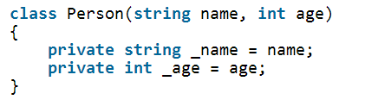
Simplified Primary Constructor

Slide 18
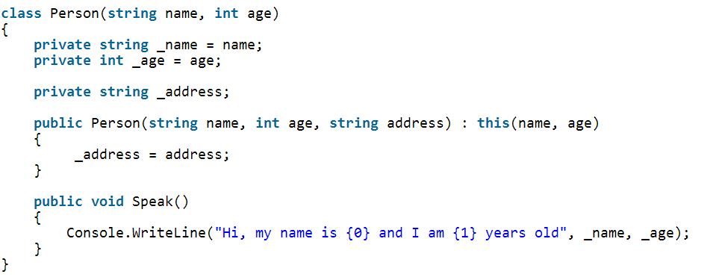
Simplified Primary Constructor

Slide 19
C# 6.0
Null Propagation
Notes:
In Slide Show mode, click the arrow to enter the PowerPoint Getting Started Center.

Slide 20
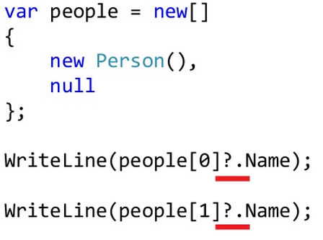
Null Propagation

Slide 21
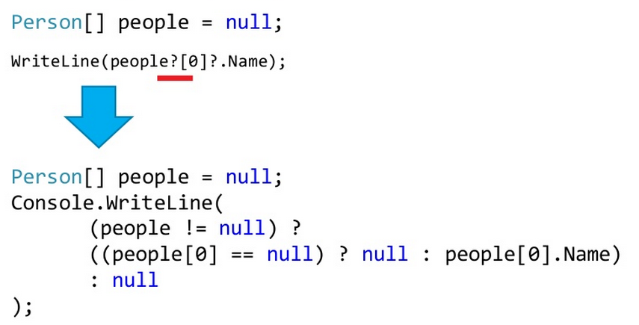
Null Propagation

Slide 22
C# 6.0
Expression Bodied Example
Notes:
In Slide Show mode, click the arrow to enter the PowerPoint Getting Started Center.

Slide 23
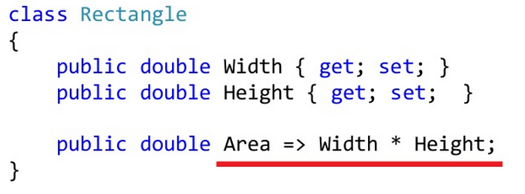
Expression Bodied Example

Slide 24
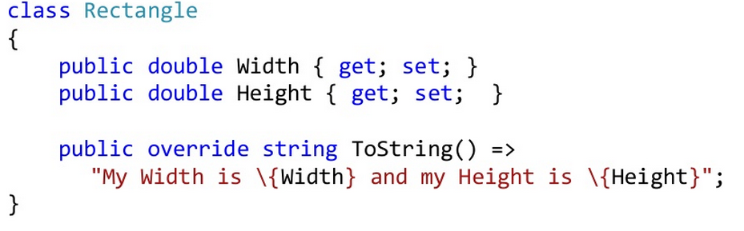
Expression Bodied Example

Slide 25
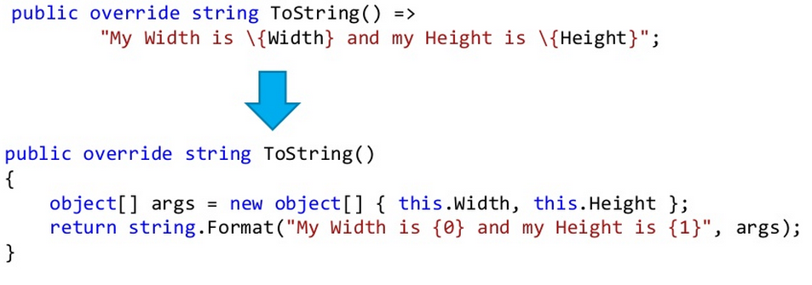
Expression Bodied Example + String interpolation

Slide 26
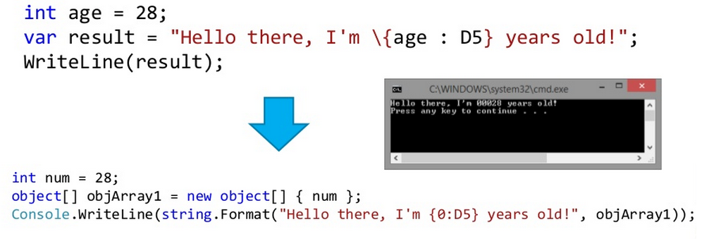
Expression Bodied Example + String interpolation

Slide 27
C# 6.0
Exception Filters
Notes:
In Slide Show mode, click the arrow to enter the PowerPoint Getting Started Center.

Slide 28
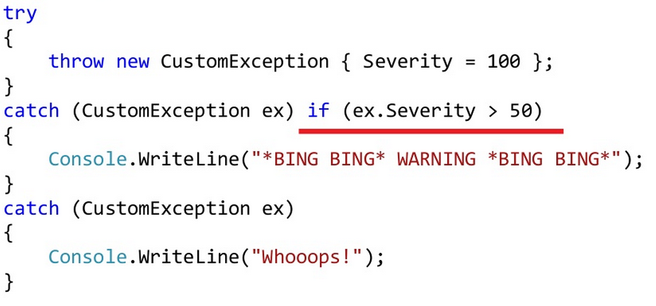
Exception Filter

Slide 29
C# 6.0
nameof example
Notes:
In Slide Show mode, click the arrow to enter the PowerPoint Getting Started Center.

Slide 30
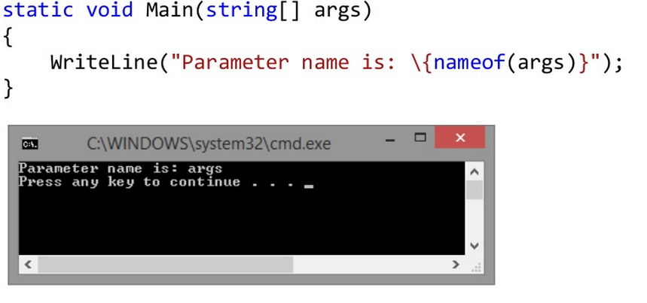
nameof Example

Slide 31
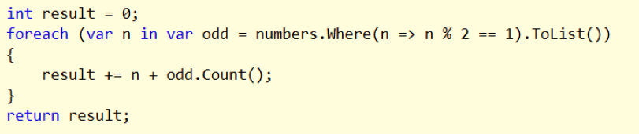
C# 6.0
Foreach var creation
Notes:
In Slide Show mode, click the arrow to enter the PowerPoint Getting Started Center.

Slide 32
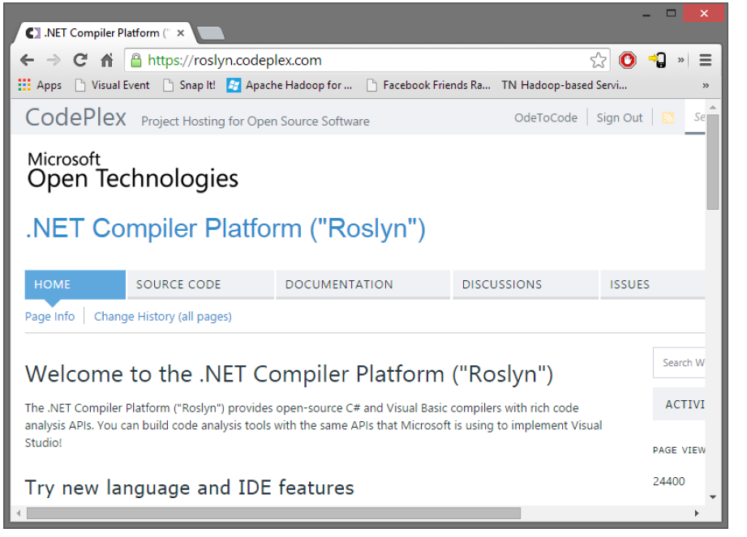
C# 6.0
Roslyn Compiler
Notes:
In Slide Show mode, click the arrow to enter the PowerPoint Getting Started Center.

Slide 33
Web Platform
Improvements
Notes:
In Slide Show mode, click the arrow to enter the PowerPoint Getting Started Center.

Slide 34
Publish
Now it will be cross platform
Notes:
In Slide Show mode, click the arrow to enter the PowerPoint Getting Started Center.

Slide 35
Publish
Now it will be cross platform
Windows | Mac | Linux
Notes:
In Slide Show mode, click the arrow to enter the PowerPoint Getting Started Center.

Slide 36
Publish
Problem fixes like new fetures
Notes:
In Slide Show mode, click the arrow to enter the PowerPoint Getting Started Center.

Slide 37
Gruntt
Project.json example
Notes:
In Slide Show mode, click the arrow to enter the PowerPoint Getting Started Center.

Slide 38
Roslyn
Don’t have to rebuild
Notes:
In Slide Show mode, click the arrow to enter the PowerPoint Getting Started Center.

Slide 39
Target Specific Framework
Core Vs. Full
Notes:
In Slide Show mode, click the arrow to enter the PowerPoint Getting Started Center.

Slide 40
Visual Studio 2015
IDE Improvements
Notes:
In Slide Show mode, click the arrow to enter the PowerPoint Getting Started Center.

Slide 41
Code Assist
Error + Light Bulb Solution
Notes:
In Slide Show mode, click the arrow to enter the PowerPoint Getting Started Center.

Slide 42
Code Assist
Live Static Analysis
Notes:
In Slide Show mode, click the arrow to enter the PowerPoint Getting Started Center.

Slide 43
Refactoring
Renaming
Notes:
In Slide Show mode, click the arrow to enter the PowerPoint Getting Started Center.

Slide 44
Refactoring
Preview
Notes:
In Slide Show mode, click the arrow to enter the PowerPoint Getting Started Center.

Slide 45
Refactoring
Split and Join Lines
Notes:
In Slide Show mode, click the arrow to enter the PowerPoint Getting Started Center.

Slide 46
Debugging
Enhancement
Notes:
In Slide Show mode, click the arrow to enter the PowerPoint Getting Started Center.

Slide 47
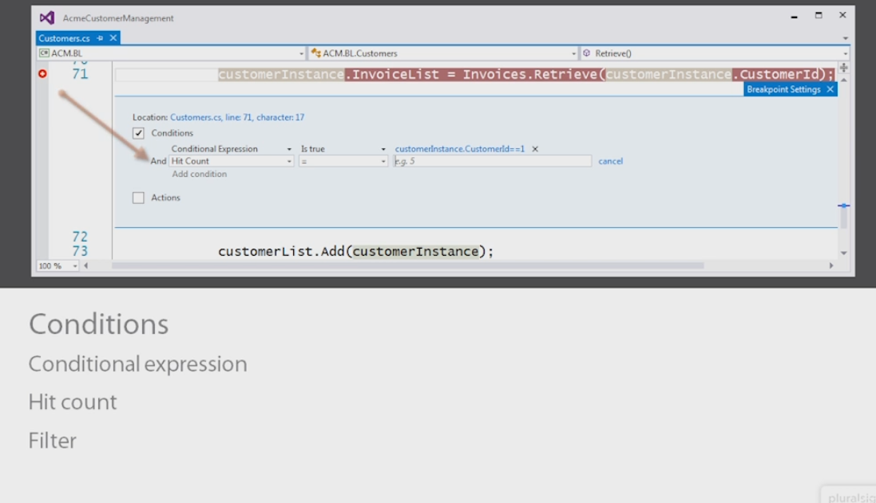

Slide 48
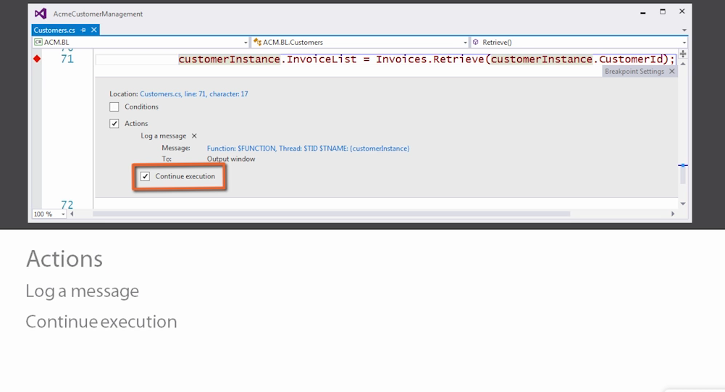

Slide 49
Debugging
PerfTip
Notes:
In Slide Show mode, click the arrow to enter the PowerPoint Getting Started Center.

Slide 50
Layout
Saving and Managing
Notes:
In Slide Show mode, click the arrow to enter the PowerPoint Getting Started Center.

Slide 51
Mobile Apps
Universal via Cordova
Notes:
In Slide Show mode, click the arrow to enter the PowerPoint Getting Started Center.

Slide 52
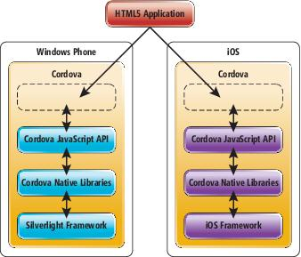
Universal App Concept

Slide 53
Questions?
Notes:
In Slide Show mode, click the arrow to enter the PowerPoint Getting Started Center.

Slide 54
Thank you
developers-organism.com
Alim Ul Karim
info@developers-organism.com
alim@developers-organism.com
/DevelopersOrganism
Notes:
In Slide Show mode, click the arrow to enter the PowerPoint Getting Started Center.

